Slide 1

Natural Language-Based Insider Threat Detection from Enterprise Communications
DSA0306 – Natural Language Processing
Presented by:
Abinesh H (192424387)
Mithlesh N (192424364)
Devin Pakianath (192325003)
Guided by:
Dr. Kumaragurubaran T

Slide 2


INTRODUCTION
Enterprise organizations generate large volumes of emails, messages, and internal communications.
Insider threats can involve data leakage, unauthorized access, policy violations, or malicious activities.
Traditional manual monitoring is time-consuming and difficult to scale.
Natural Language Processing (NLP) can analyze the language used in communications.
Machine Learning can classify messages and identify potentially suspicious behavior.
The proposed system provides threat scores, risk levels, threat categories, and suspicious indicators to support security analysts.

Slide 3
PROBLEM STATEMENT
Enterprise communication data is increasing rapidly.
Manual monitoring of emails and messages is time-consuming and inefficient.
Insider threats can be hidden within normal-looking communications.
Detecting data leakage, unauthorized access, and malicious intent at an early stage is difficult.
Security teams need to prioritize large numbers of communications based on risk.
Traditional methods may not provide fast and explainable threat assessment.
Therefore, an automated NLP and Machine Learning-based system is needed to detect and prioritize potential insider threats.

Slide 4
OBJECTIVES
To develop an NLP-based system for detecting insider threats in enterprise communications.
To preprocess and analyze communication text using Natural Language Processing.
To classify communications into different threat categories using Machine Learning.
To generate a 0–100 threat score for each communication.
To assign risk levels such as LOW, MEDIUM, HIGH, and CRITICAL.
To identify suspicious indicators such as data transfer, confidential information, credentials, and concealment.
To provide alerts and analytics for high-risk communications.
To provide a user-friendly dashboard for security monitoring and investigation.

Slide 5
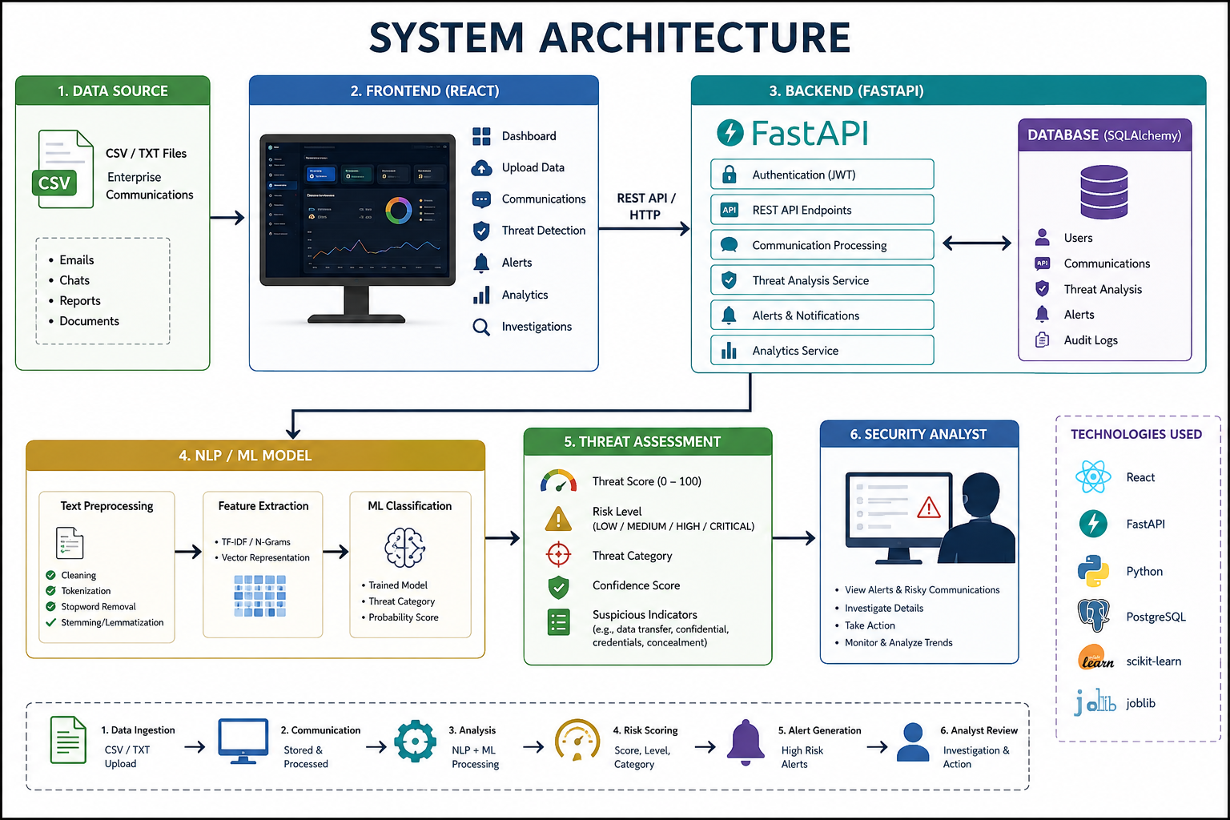
System Architecture

Slide 6
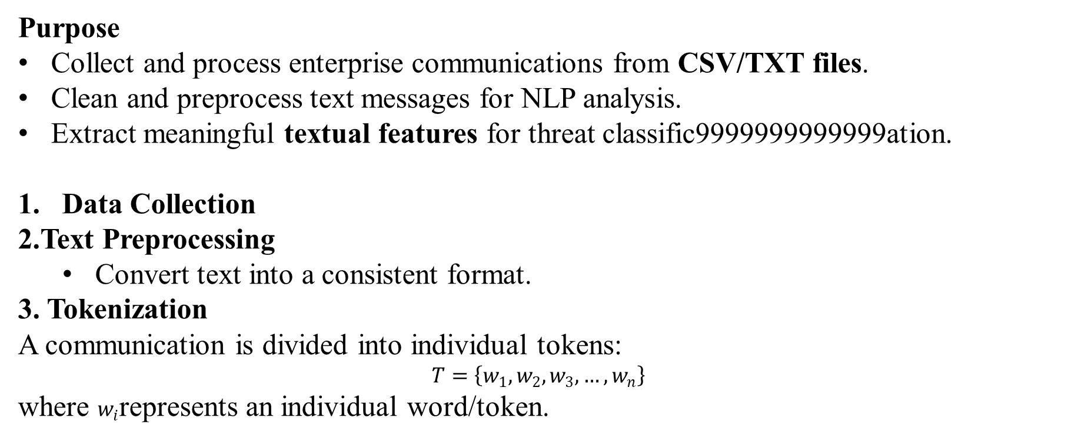
Module 1: Enterprise Communication Processing & Feature Extraction
Purpose
Collect and process enterprise communications from CSV/TXT files.
Clean and preprocess text messages for NLP analysis.
Extract meaningful textual features for threat classific9999999999999ation.
Data Collection
2.Text Preprocessing
Convert text into a consistent format.
3. Tokenization
A communication is divided into individual tokens:
$$T=\left\{w_{1} , w_{2} , w_{3} , … , w_{n}\right\}$$
where $w_{i}$represents an individual word/token.
Example:
"I will transfer the confidential files"
T={I,will,transfer,confidential,files}

Slide 7
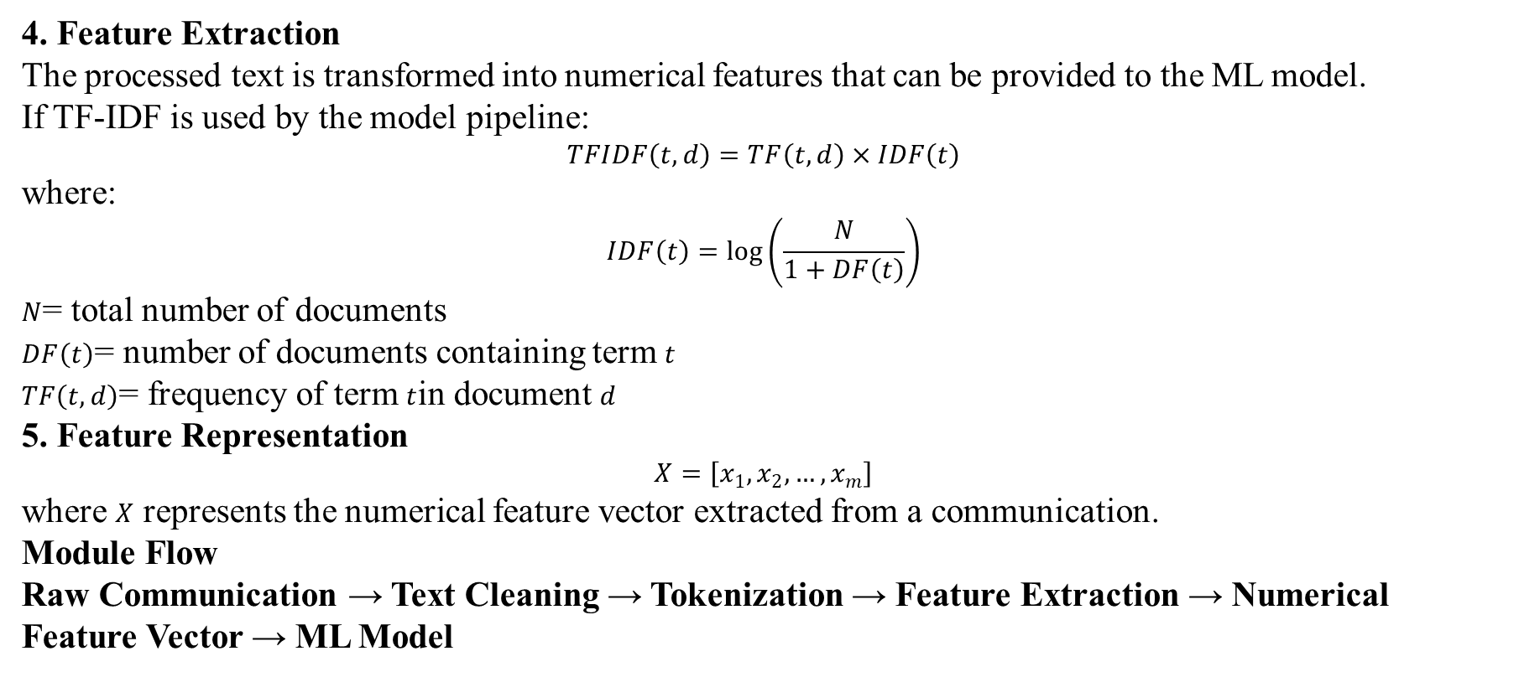
Module 1: Enterprise Communication Processing & Feature Extraction
4. Feature Extraction
The processed text is transformed into numerical features that can be provided to the ML model.
If TF-IDF is used by the model pipeline:
$$TFIDF\left(t , d\right)=TF\left(t , d\right)×IDF\left(t\right)$$
where:
$$IDF\left(t\right)=\log\left(\frac{N}{1+DF\left(t\right)}\right)$$
$N$= total number of documents
$DF\left(t\right)$= number of documents containing term $t$
$TF\left(t , d\right)$= frequency of term $t$in document $d$
5. Feature Representation
$$X=\left[x_{1} , x_{2} , … , x_{m}\right]$$
where $X$ represents the numerical feature vector extracted from a communication.
Module Flow
Raw Communication → Text Cleaning → Tokenization → Feature Extraction → Numerical Feature Vector → ML Model

Slide 8
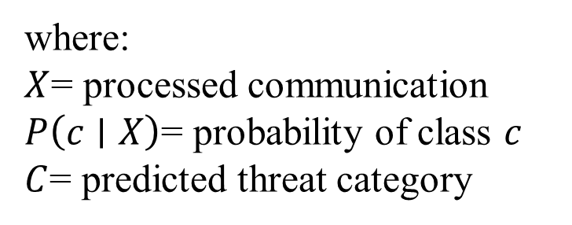
Module 2: Insider Threat Detection & Risk Assessment
Purpose
Classify communications into different insider-threat categories.
Calculate a threat score and confidence score for each communication.
Identify suspicious indicators and assign LOW, MEDIUM, HIGH, or CRITICAL risk levels.
1. Machine Learning Classification
The processed communication is passed to the trained ML model.
The model predicts one of the following categories:
Normal
Policy Violation
The predicted class is:
C=argcmax​P(c∣X)
where:
$X$= processed communication
$P\left(c∣X\right)$= probability of class $c$
$C$= predicted threat category

Slide 9
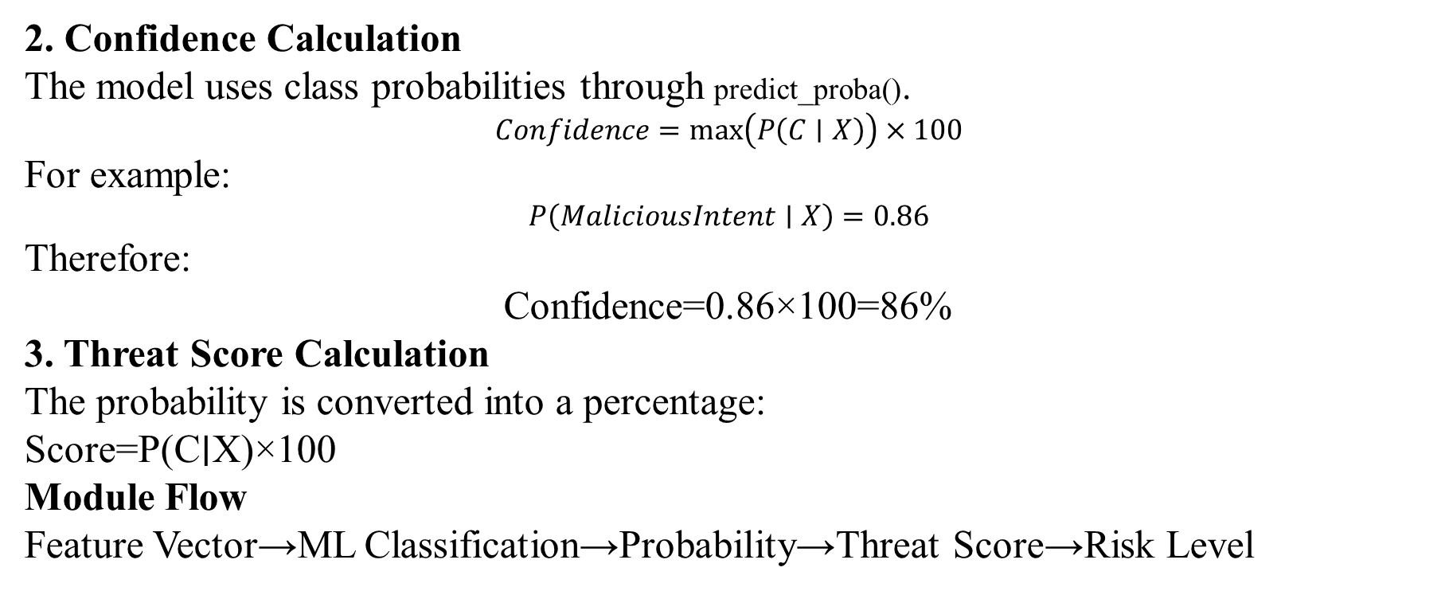
Module 2: Insider Threat Detection & Risk Assessment
2. Confidence Calculation
The model uses class probabilities through predict_proba().
$$Confidence=max⁡\left(P\left(C∣X\right)\right)×100$$
For example:
$$P\left(MaliciousIntent∣X\right)=0.86$$
Therefore:
Confidence=0.86×100=86%
3. Threat Score Calculation
The probability is converted into a percentage:
Score=P(C∣X)×100
Module Flow
Feature Vector→ML Classification→Probability→Threat Score→Risk Level

Slide 10
Module 3: Security Monitoring Dashboard, Alert Management & Threat Investigation
Purpose
To provide a centralized platform for monitoring, analyzing, and managing detected insider threats.
Key Features:
Centralized Security Dashboard – Displays overall communication and threat statistics.
Risk-Level Monitoring – Classifies threats as LOW, MEDIUM, HIGH, and CRITICAL.
Automated Alert Generation – Creates alerts for suspicious and high-risk communications.
Threat Score Display – Shows the calculated risk score for each communication.
Threat Category Identification – Displays categories such as security risk, data exfiltration, and malicious intent.
Technologies Used: React.js | FastAPI | MySQL | SQLAlchemy | JavaScript | HTML/CSS

Slide 11
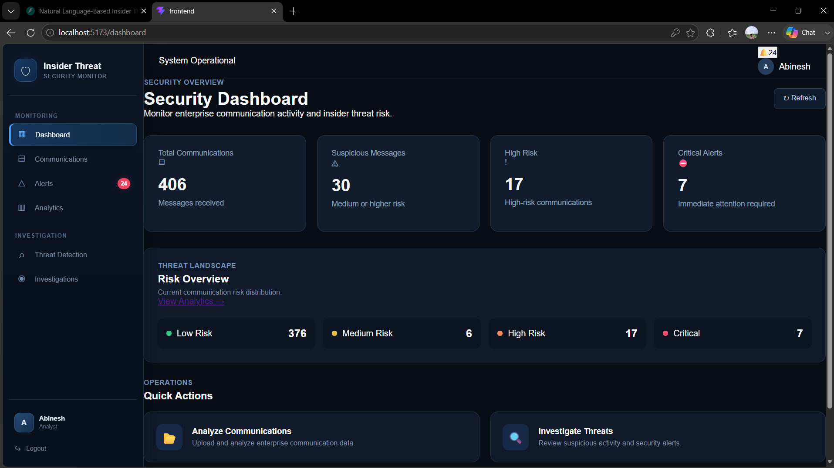
IMPLEMENTATION

Slide 12
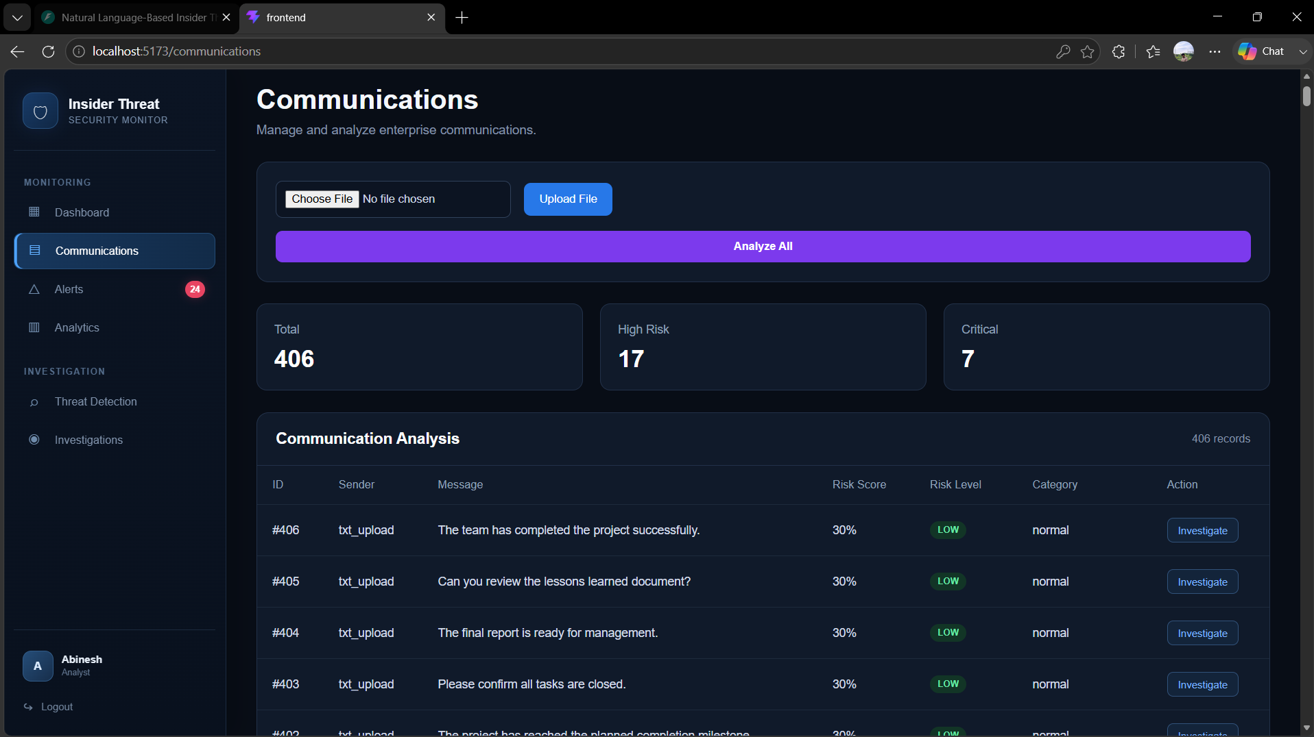
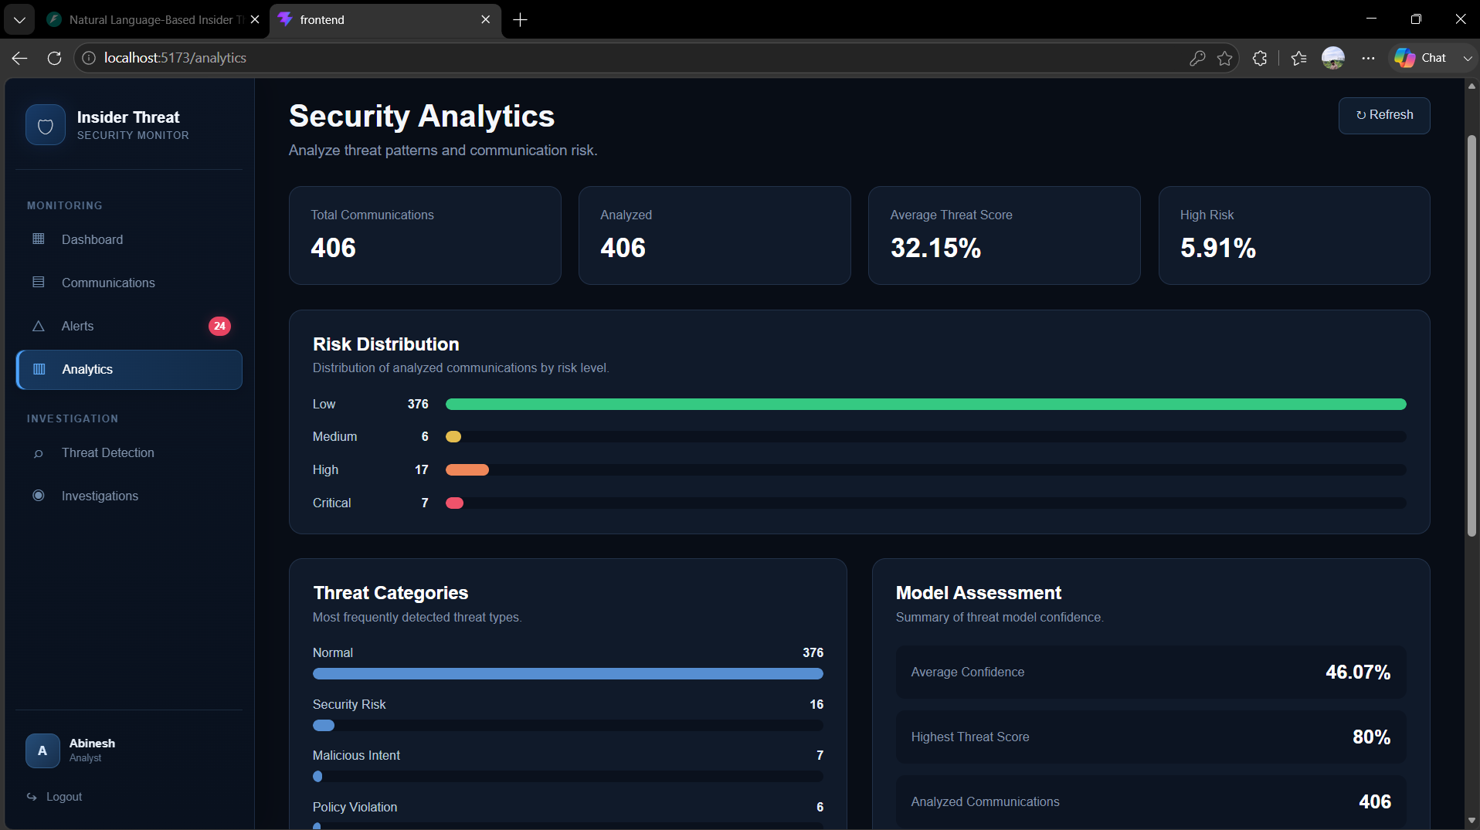
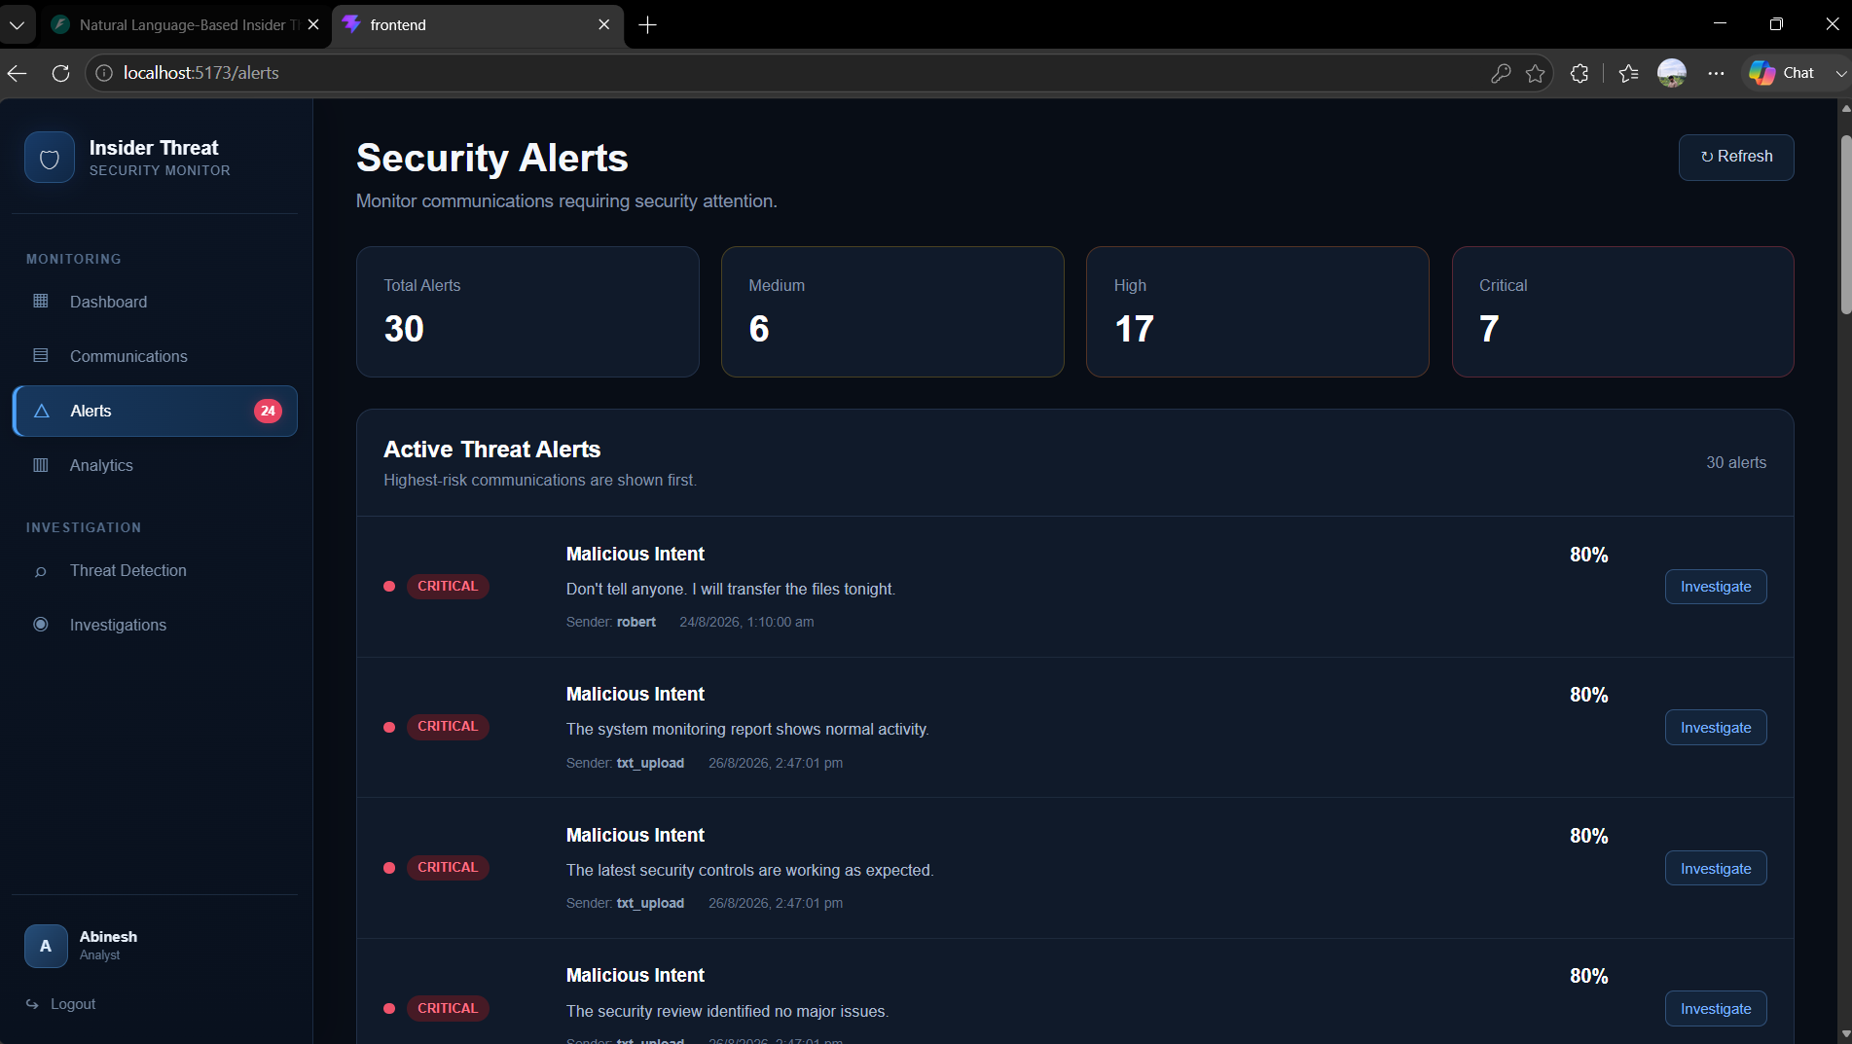
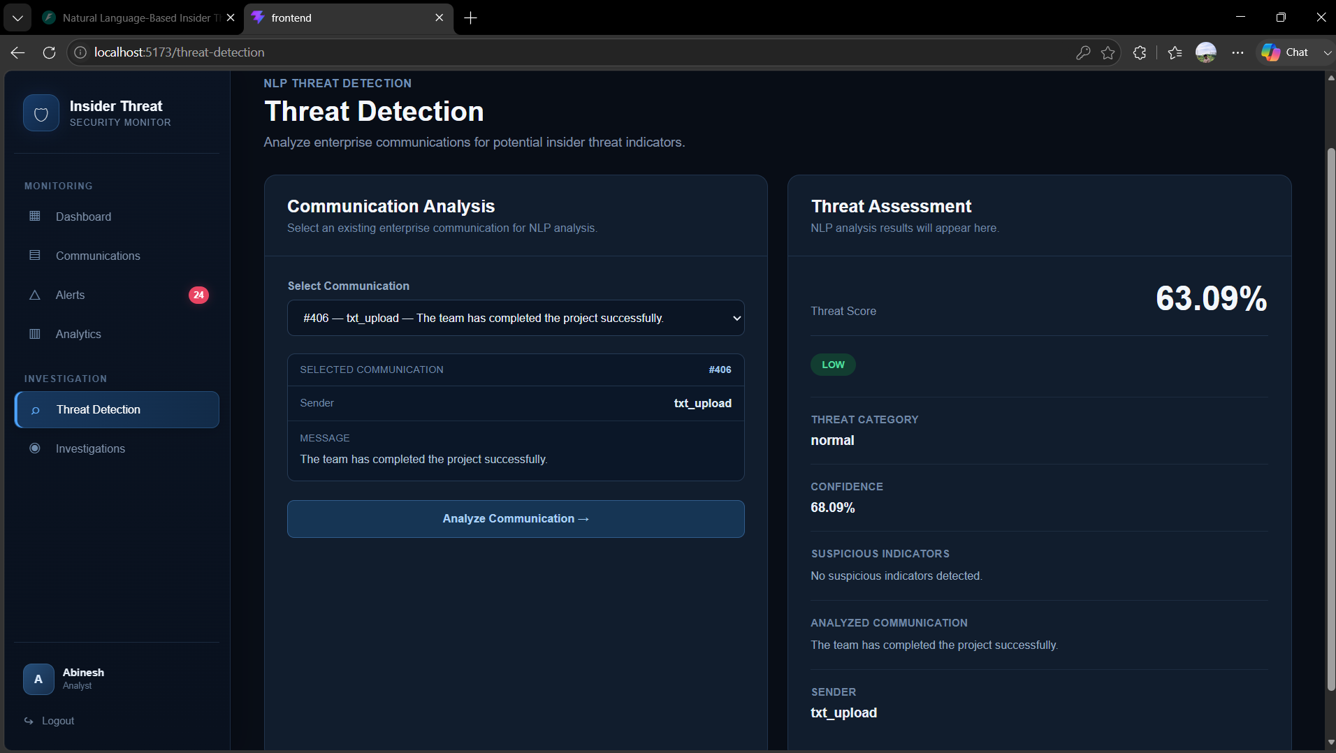
IMPLEMENTATION

Slide 13
Conclusion
Developed an NLP-based insider threat detection system for analyzing enterprise communications.
The system processes communication data and classifies messages into different threat categories.
Generates threat scores, confidence levels, risk levels, and suspicious indicators.
Future Scope
Integrate real-time email, chat, and enterprise communication monitoring.
Improve detection accuracy using larger and more diverse real-world datasets.
Implement advanced NLP models such as BERT, RoBERTa, or transformer-based models.
Deploy the system on cloud infrastructure for scalable enterprise usage.

Slide 14
THANK YOU!

